Slide 1

Central Processing Unit: Introduction, General Register Organization
Prepared By
Dr. Tajinder Kaur
AP,DICE

Slide 2
Outline
Central Processing Unit (CPU)
Introduction
General Register Organization

Slide 3
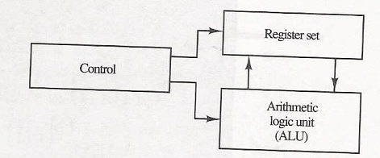
Introduction
The part of computer that performs the bulk of data-processing operations is called the central processing unit and is referred to as the CPU.
The CPU is made up of three major parts:
The register set: stores intermediate data used during the execution of the instruction.
The ALU: performs the required microoperations for executing the instructions.
The control unit: supervise the transfer of information among the registers and instruct the ALU as to which operation to perform.

Slide 4
General Register Organization
Memory locations are needed for storing pointers, counters, return address, temporary result etc. Having to refer to memory location for such applications is time consuming.
because memory access is the most time-consuming operation in the computer.
It is more convenient and more efficient to store these intermediate values in processor registers. All of these registers are connect to a common bus system.
The register communicate with each other not only for direct data transfer, but also while performing various micro operations.

Slide 5
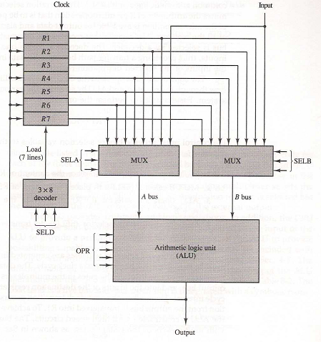
BUS System
The bus organization of 7-registers:

Slide 6
BUS System
To perform operation:
The control must provide binary selection variables to the following sectors inputs:
MUX A Sector (SELA): to place the content of R2 into bus A.
MUX B Sector (SELB): to place the content of R3 into bus B.
ALU operation Selector (OPR): To provide the arithmetic addition A+B.
Decoder Destination Selector (SELD): To transfer content of output bus in to R1.

Slide 7
BUS System
The four control selection variables are generated in control unit and must be available at the beginning of clock cycle.
The data from two source registers propagates through the gates in the multiplexers and the ALU, to the output bus, and into inputs of the destination register, all during the clock cycle interval.
When the next clock transition occurs, the binary information from the output bus is transferred into R1.

Slide 8

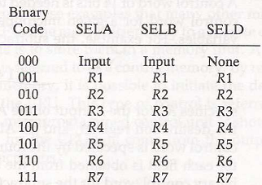
Control Word
There are 14 binary selection inputs in the unit, and their combined value specifies a control word.
The encoding of register selection field as:

Slide 9
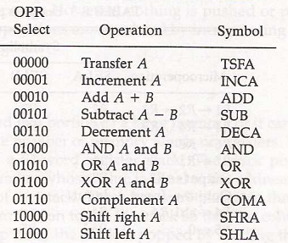
Control Word
The encoding of ALU operation as:
ALU provides arithmetic and logic operations. In addition, the CPU must provide shift operations.
The shifter may be placed in the input of the ALU to provide preshift capability, or at the output of ALU to provide postshift capability. Some times it included in ALU.

Slide 10


Microoperations
A control word of 14 bits is needed to specify a microoperations in the CPU.
E.g.
A memory unit that stores control word is referred to as a CONTROL MEMORY.
By reading consecutive control words from memory, it is possible to initiate the desire sequence of microoperations for the CPU. This type of control is referred As micro-programmed control.

Slide 11
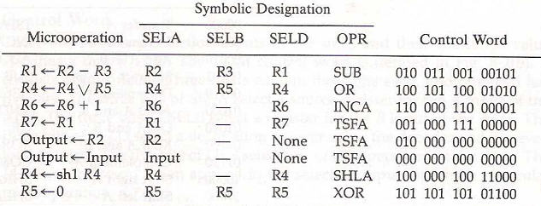
Microoperations

Slide 12
Self Assessment
State whether the following statements are true or false-
The control unit fetches the instructions from the registers, decodes and then executes it.
The registers store the status of the CPU as well as information about the currently executing program.

Slide 13
MCQ
The CPU reads and writes data to and from ________________and transfers data to and from I/O devices.
(i) Memory system
(ii) Register
(iii) Control unit
(iv) Arithmetic and logic unit
Constant registers is used to store _______________.
(i) Floating point numbers
(ii) Read-only values
(iii) Addresses
(iv) Programs

Slide 14
Thank You

